Slide 1
Unit 3-1
Parallel Lines and Transversals
PLANE Geometry

Slide 2

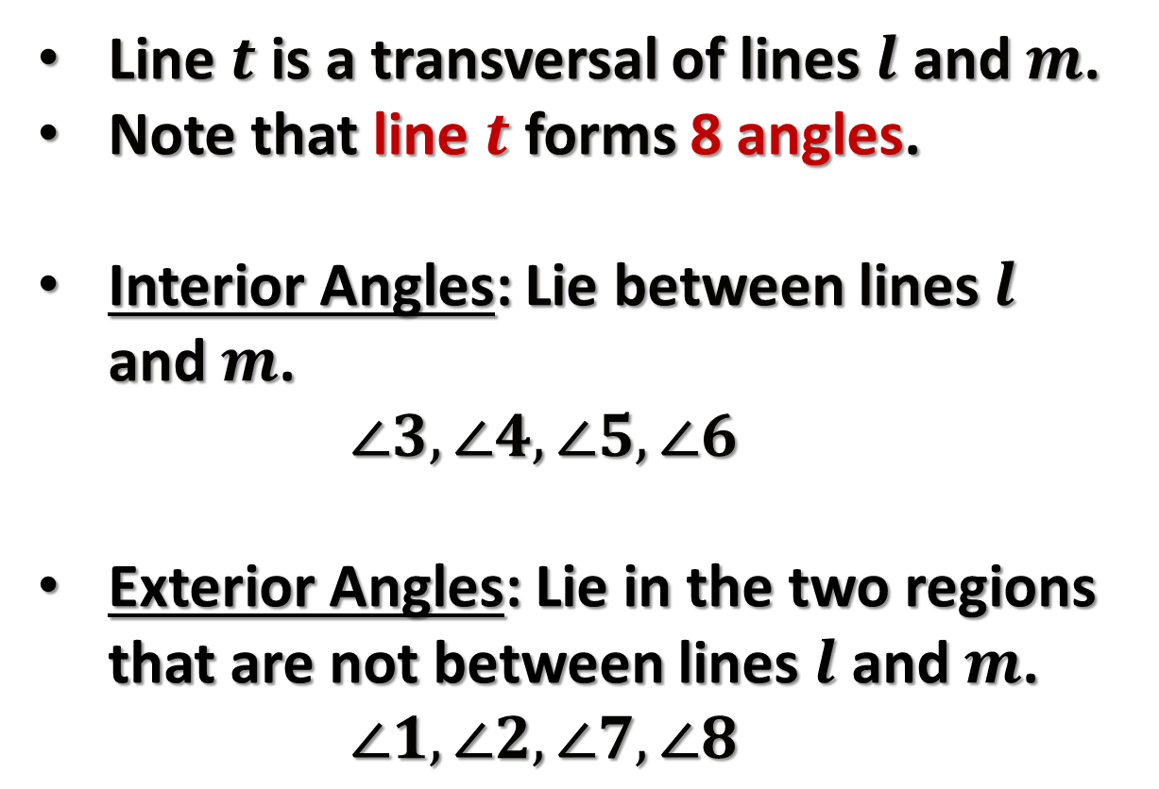










Transversal:
A Line that Intersects 2 or More Coplanar Lines at 2 Distinct Points
$$m$$
Line $t$ is a transversal of lines $l$ and $m$.
Note that line $t$ forms 8 angles.
Interior Angles: Lie between lines $l$ and $m$.
  $$∠3, ∠4, ∠5, ∠6$$
Exterior Angles: Lie in the two regions that are not between lines $l$ and $m$.
  $$∠1, ∠2, ∠7, ∠8$$
$$t$$
$$l$$
$$7$$
$$5$$
$$8$$
$$6$$
$$3$$
$$1$$
$$4$$
$$2$$

Slide 3















Types of Angles:
Alternate Interior Angles: Nonadjacent interior angles that lie on opposite sides of transversal $t$.
$$m$$
$$t$$
$$l$$
Alternate Exterior Angles: Nonadjacent exterior angles that lie on opposite sides of transversal $t$.
$$7$$
$$5$$
$$8$$
$$6$$
$$3$$
$$1$$
$$4$$
Corresponding Angles: Angles that lie on the same side of transversal $t$ and on the same side of lines $l$ and $m$.
$$2$$
Same-Side Interior Angles (Consecutive Interior Angles): Interior angles that lie on the same side of transversal $t$.

Slide 4

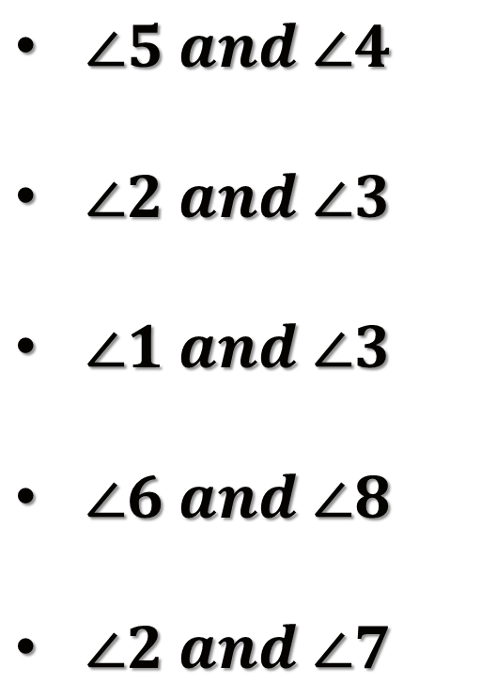





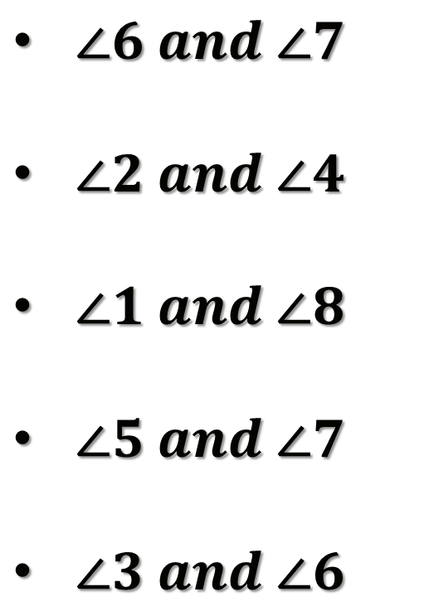
Example 1:
Classify the given pairs of angles.
$∠5 and ∠4$
$∠2 and ∠3$
$∠1 and ∠3$
$∠6 and ∠8$
$∠2 and ∠7$
$∠6 and ∠7$
$∠2 and ∠4$
$∠1 and ∠8$
$∠5 and ∠7$
$∠3 and ∠6$
$$m$$
$$t$$
$$l$$
$$4$$
$$3$$
$$8$$
$$7$$
$$2$$
$$1$$
$$6$$
$$5$$

Slide 5
Alternate Interior Angles:
If 2 parallel lines are cut by a transversal, then each pair of Alternate Interior Angles is congruent.
$$m$$
$$t$$
$$l$$
$$7$$
$$5$$
$$8$$
$$6$$
$$3$$
$$1$$
$$4$$
$$2$$

Slide 6




Example 2:
Find the missing angles.
$$m$$
$$t$$
$$l$$
$$a$$
$$75°$$
$$5b$$
$$105°$$

Slide 7
Alternate Exterior Angles:
If 2 parallel lines are cut by a transversal, then each pair of Alternate Exterior Angles is congruent.
$$m$$
$$t$$
$$l$$
$$7$$
$$5$$
$$8$$
$$6$$
$$3$$
$$1$$
$$4$$
$$2$$

Slide 8




Example 3:
Find the missing angles.
$$m$$
$$t$$
$$l$$
$$y$$
$$94°$$
$$2x$$
$$86°$$

Slide 9
Corresponding Angles:
If 2 parallel lines are cut by a transversal, then each pair of Corresponding angles is congruent.
$$m$$
$$t$$
$$l$$
$$7$$
$$5$$
$$8$$
$$6$$
$$3$$
$$1$$
$$4$$
$$2$$

Slide 10


Example 4:
Find the missing angle.
$$m$$
$$t$$
$$l$$
$$121°$$
11$x$

Slide 11
Same-Side Interior Angles:
If 2 parallel lines are cut by a transversal, then each pair of Same-Side Interior Angles is Supplementary.
$$m$$
$$t$$
$$l$$
$$7$$
$$5$$
$$8$$
$$6$$
$$3$$
$$1$$
$$4$$
$$2$$

Slide 12


Example 5:
Find the missing angle.
$$m$$
$$t$$
$$l$$
$$114°$$
$$x$$

Slide 13






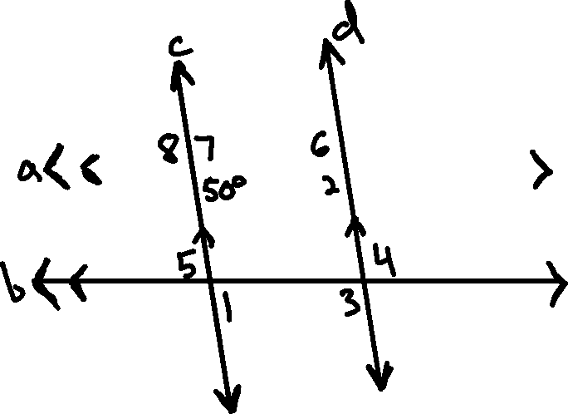


Example 6:
Find the missing angles.
$$m∠1=________$$
$$m∠2=________$$
$$m∠3=________$$
$$m∠4=________$$
$$m∠5=________$$
$$m∠6=________$$
$$m∠7=________$$
$$m∠8=________$$

Slide 14
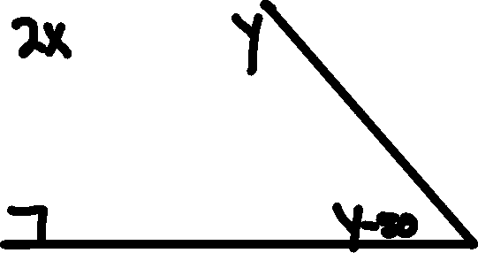


Example 7:
Find the missing angles.

